Slide 1
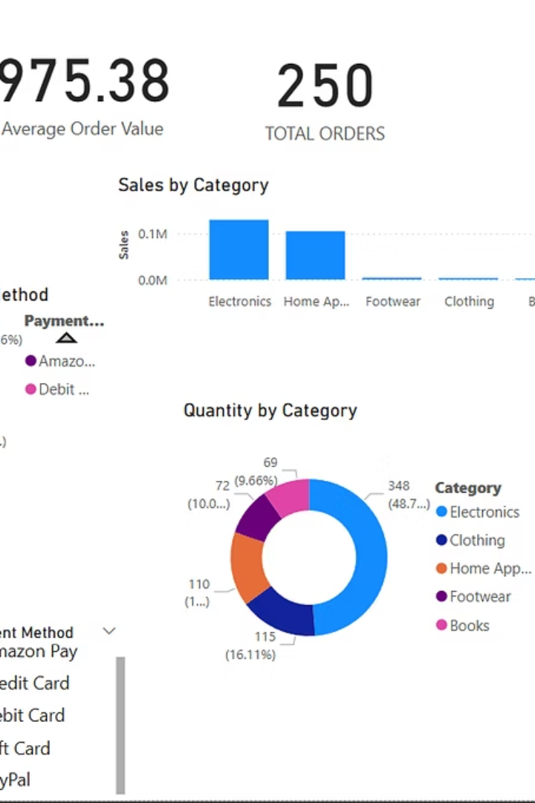
Sales Dashboard: Insights & Recommendations
This presentation summarizes key insights from the Sales & Financial Dashboard built using Power BI. We leverage Amazon Sales Data from Kaggle to monitor sales trends, analyze customer behavior, and track KPIs.

Slide 2
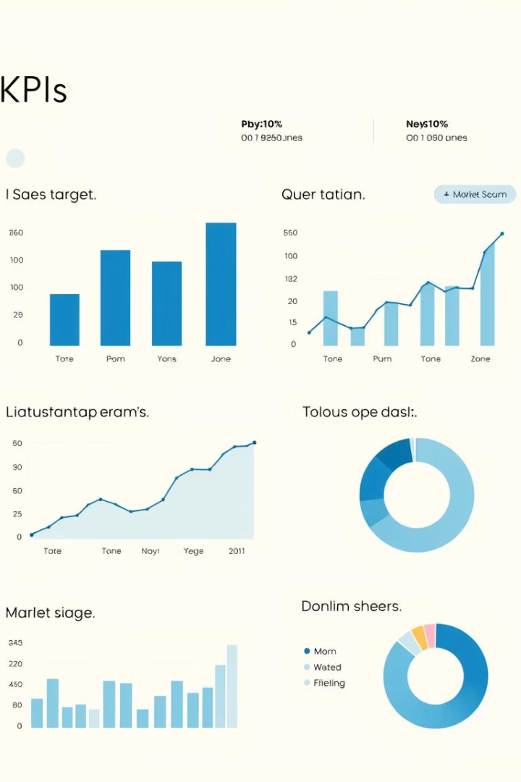
Key Performance Indicators
₹244K
250
Total Sales
Total Orders
Overall revenue generated.
Total number of transactions.
₹975.38
Avg. Order Value
Average revenue per order.
Our KPIs provide a snapshot of our sales performance. Filters include Category, Customer Location, and Payment Method.

Slide 3
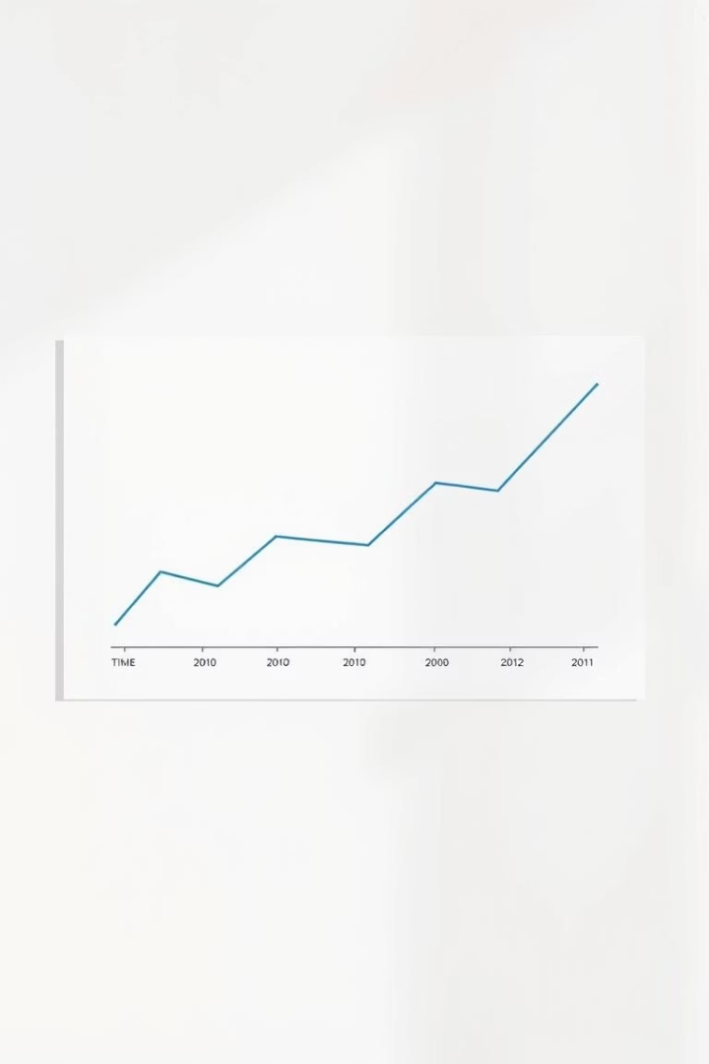



Monthly Sales Performance
February
Sales begin to increase.
March
Steady growth continues.
April
Peak sales achieved.
The combo chart shows total sales and quantity sold by month. A steady growth trend is observed from February to April, peaking in April.

Slide 4
Category & Customer Analysis
Top Categories
Top Customers
Electronics
Olivia
Books
Jane
Clothing
Olivia and Jane are top contributing customers. Focus on customer retention to maintain growth.
Electronics lead in both sales and quantity sold. Books and Clothing consistently perform well.

Slide 5

Customer & Payment Insights
Top Cities
Los Angeles
New York
Major cities drive high sales volumes.
Payment Methods
Amazon Pay
Debit Cards
Amazon Pay and Debit Cards are most popular.

Slide 6

Recommendations & Next Steps
Improve Locations
Incentivize Payments
Expand Top Lines
Target lesser-performing locations with offers and promotions.
Promote low-usage payment methods like Gift Cards.
Focus on top-performing categories. Increase revenue by expanding top product lines.

